Slide 1
Introduction to Programming Languages

Slide 2
Goals for the Course
To understand theories pertaining to programming languages: basic automata theory as it pertains to language translation.
2. To understand how languages are designed and implemented:
  Syntax – The grammar of a language, Grammatical representations
  Semantics -- What a program means
  Basic design features of languages
  Tradeoffs inherent in the design of programming languages.
3. To understand the major programming paradigms and the most appropriate language for solving specific problems
  Procedural - C, Basic, statement oriented
  Object-Oriented - C++, Java, Smalltalk
  Functional – Lisp, Scheme, ML, Haskell
  Logic-based - Prolog
  To examine features and relative advantages of each of the language models.

Slide 3
Why Study Programming Languages?
A few basic reasons:
To increase your vocabulary of useful programming constructs.
To improve your understanding of the significance of implementation issues.
To improve your use of programming languages you already know.
To allow a better choice of programming language for a particular job.
To make it easier to learn a new language.
To help you understand relevant issues if you need to design a new language.

Slide 4
Application Domains
Applications in the 1960s
  Business processing - mainframes using COBOL. Order entry, inventory control, personnel management.
  Scientific - numerical analysis problems, integral or differential functions, Fortran
  System - no effective high level languages - Assembler commonly used (OS360). Process control was a related application area, but not commonly computerized because of the price of computers
  Artificial Intelligence - LISP was dominant. Languages searched through large data spaces, eg: chess playing programs.

Slide 5
Application Domains
Applications of the 2000s:
  Scientific - Fortran 77/90/95/2003/2008 still widely used. C and C++ have made inroads.
  Business processing - Still COBOL, but microcomputers have changed business computing.
  Artificial Intelligence - Lisp, Scheme, Common Lisp, Prolog. Languages support Symbolic computing with substantial flexibility.
  System - C was developed and dominates for operating system construction. C is efficient and gives direct access to hardware.
  Web Software – created with many different technologies from XHTML to Java, .NET, Javascript, php, AJAX, etc.
  Smartphone – Objective C, Java, various Android development envoironments

Slide 6
A Good Language
MacLennan (1987)
1. Abstraction - Avoid requiring something to be stated more than once; factor out the recurring pattern.
2. Automation - Automate tedious, error-prone activities.
3. Defense in Depth - Have a series of defenses so that if an error isn’t caught by one, it will probably be caught by another
4. Information Hiding - The language should permit modules designed so that (1) the user has all the information needed to use the module correctly, and nothing more; (2) the implementor has all the information needed to implement the module correctly, and nothing more
5. Manifest Interface - All interfaces should be apparent (manifest) in the syntax.
6. Orthogonality - Independent functions should be controlled by independent mechanisms.
7. Portability - Avoid features or facilities that are dependant on a particular machine or small class of machines.

Slide 7
A Good Language
8. Preservation of Information - The language should allow the representation of information that the user might know and that the compiler might need.
9. Regularity - Regular rules, without exceptions are easier to learn, use, describe and implement.
10. Security - No program that violates the definition of the language, or its own intended structure, should escape detection
11. Simplicity - A language should be as simple as possible. There should be a minimum number of concepts with simple rules for their combination.
12. Structure - The static structure of the program should correspond in a simple way with the dynamic structure of the corresponding computations
13. Syntactic Consistency - Similar things should look similar; different things different.
14. Zero-One-Infinity - The only reasonable numbers are zero, one and infinity.

Slide 8
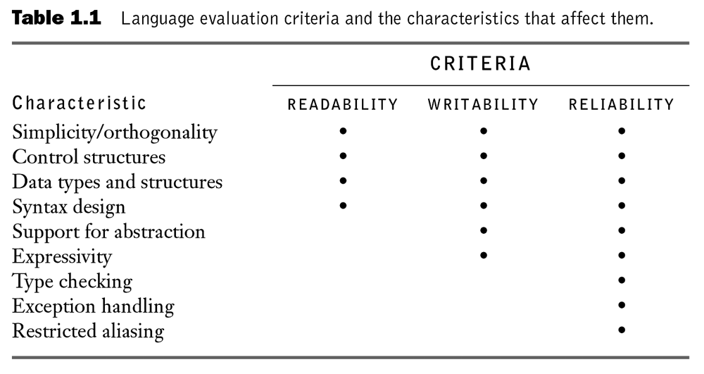
A Good Language
Sebesta's Criteria

Slide 9
Evolution of software architectures
1950s - Large expensive mainframe computers ran single programs (Batch processing)
1960s - Interactive mainframe programs (time-sharing)
1970s - Development of Minicomputers (DEC VAX) and the first microcomputers. Apple II. Early work on windows, icons, and PCs at XEROX PARC
1980s - Personal computer - Microprocessor, IBM PC and Apple Macintosh. Use of windows, icons and mouse
1990s - Client-server computing - Networking, the Internet and World Wide Web
2000s – Wireless computing, integrated and adaptive environments

Slide 10
Language Goals
During 1950s--1960s - Compile programs to execute efficiently…
  Programmers were cheap, machines were expensive
  Direct connection between language features and hardware - integers, reals, goto statements
But today…
  Compile programs that are created efficiently (development is expensive)
  CPU power and memory are cheap on desktops
  Power and memory are still issues for embedded systems
  Optimization concerns are different for mobile, optimize for low power consumption
  Direct connection between language features and design concepts - encapsulation, records, inheritance, functionality, assertions

Slide 11
Language Categories
Syntactic differences do not define the fundamental differences among languages.
Computational models:
  Imperative languages – command-driven or statement based. Like machine states. A program is a sequence of states that change with each command that is executed. FORTRAN, Algol, Pascal, C, Ada83 support this paradigm
  Object-oriented languages - Data objects are identified and constructed with a limited set of methods that can be invoked on instances of those objects. C++, Java, C#, Smalltalk are examples.
  Functional languages – Start with consideration of what functions must be applied to the initial state of the computation in order to perform the desired tasks (called applicative or functional). Lisp and ML are examples.
  Rule-based Languages – execute by attempting to match enabling conditions. If a match can be made, appropriate actions are carried out and the computation attempts to match subsequent enabling conditions. Prolog is a typical example.

Slide 12
Programming Environments
Programming Environment definition:
  A body of tools to create, manipulate, view, edit and manage programs.
Components of a Programming Environment (IDE):
  Editor
  Execution components:
    Code production
    Debugging facilities
  Version control
  Verification and testing tools
  Program generation aids
  Class libraries
Examples:
  Netbeans
  Eclipse
  Microsoft .NET Environment

Slide 13
Operating Environments
Host Environment - environment in which programs are developed
Target Environment - environment in which the program executes
Target Environments:
  Batch processing
  Interactive
  Embedded
1. Batch Environments
Earliest and simplest, although still used today.
COBOL and FORTRAN were commonly used in batch environments
Effects on Language Design
  Files are the basis for input-output structures
  Errors that terminate program are costly but acceptable
  No particular timing constraints on program execution

Slide 14
Operating Environments
2. Interactive
Most common today on PCs and workstations.
Effects on Language Design
  Input from keyboard or mouse
  Error checking emphasis more on input than on internal error conditions as program executes.
  Some notion of timing constraints (response time)
3. Embedded
The computer system is embedded in and an integral part of a larger system.
Effects on language Design
  Failure can be disasterous or even life-threatening
  Reliability and correctness are the primary attributes of programs in these environments
  Often real-time - critical time constraints on system response

Slide 15
Implementation Methods
Compilation
  Direct translation into architecture-dependent machine code
  Fast
  Enables many checks
  Compile/link/load sequence
Pure Interpretation
  No prior translation
  Easy implementation of debuggers
  Slow execution
Hybrid Implementation Systems
  Compilation to an intermediate form
  Interpretation or
  JIT Compilation
Preprocessors
  Run before compilation
  "macro expander"

Slide 16
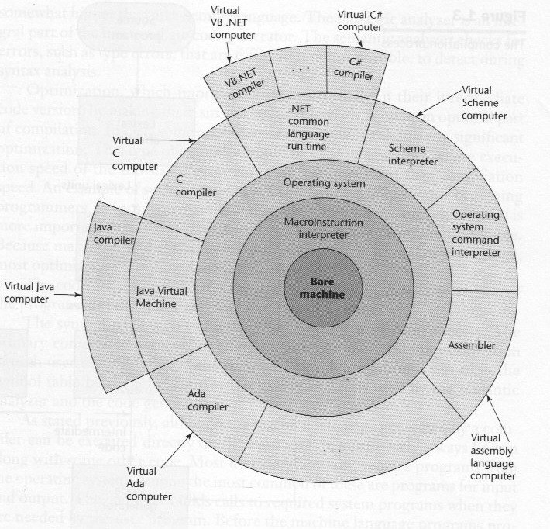
Layers of Virtual Machines

Slide 17
Programming Language
Capability
A view could be taken of the theoretical vs the practical power of a programming language.
  Turing Computable – addresses the capabilities of general-purpose languages
  The issue is what is possible, not what is convenient
Beneath the surface, most languages are similar. Programming language features are added for convenience, not to enhance capability in the most basic sense.
Böhm, Jacopini. "Flow diagrams, turing machines and languages with only two formation rules" Comm. ACM, 9(5): 366-371, May 1966.
Consider a bare-bones language.
Bare Bones:
  Data description - string of bits
  Process description - clear, incr, decr
  Control:
    while datalabel not 0 do
  . . .
    end

Slide 18
A Bare Bones Language
Computing 2 x 3 using Bare Bones:
clear Y; incr Y; incr Y;
clear X; incr X;incr X;incr X;clear Z;
while X not 0 do;
clear W;
while Y not 0 do;
incr Z;
incr W;
decr Y;
end;
while W not 0 do
incr Y
decr W;
end;
decr X;
end;

Slide 19
Low versus high-level Languages
No programming language can prevent us from finding certain solutions to a problem, but a given language can influence the types of solutions we are likely to pursue.
The following maps a progression from low-level to increasingly high levels of abstraction in programming languages
Machine Language
2. Assembly Language
3. Assembly Language with Symbolic Addresses
4. High Level Languages:
5. Object Oriented approaches, reusable components

Slide 20
Creation of Standards
Language standards defined by national standards bodies:
  ISO - International Standards Organization
  IEEE - Institute of Electrical and Electronics Engineers
  ANSI - American National Standards Institute
All work in a similar way:
  1. A working group of volunteers is set up to define the standard
  2. They seek agreement on features for new standard
  3. They vote on the standard
  4. If approved by the working group, it is submitted to the parent organization for approval.

Slide 21
Creation of Standards
Standards in the US are voluntary:
NIST - National Institute for Standards and Technology develops standards that are only required on federal agencies, not for commercial organizations.
Consensus is the key to standards making.
Contentious features are often omitted to gain consensus
Only vendors have a vested interest in the results
Users don't care until a standard is approved, and then it is too late!

Slide 22
Standards-Conforming Programs
Standards define behavior for a standards conforming program - one that meets the rules of the language standard
In general (except for Ada), behavior of non-conforming program is not specified, so any extensions to a standards conforming compiler may or may not still be conformant
Standards are supposed to be reviewed every 5 years
  Examples:
  FORTRAN 1966, 1977, 1990
  Ada 1983, 1995

Slide 23
When to standardize a language?
Problem: When to standardize a language?
If too late - many incompatible versions - FORTRAN in 1960s was already a de facto standard, but no two versions were the same
If too early - no experience with the language - Ada in 1983 had no running compilers
Just right - Probably Pascal in 1983, although it is now an obsolete language
Other languages:
  C/C++ in 1988
  LISP in 1990 - Way too late
  ML - One major implementation: SML
  Smalltalk - 1998
  Prolog – none

Slide 24
Internationalization
Internationalization - How to specify languages useful in a global economy?
Characters used internationally:
Single 8-bit byte - 256 character values
  A lot in 1963, but insufficient today
ASCII specifies 128 character codes (low-order 7 bits); remainder is left to users
What about other languages?
  Additional letters: German umlaut-ä, French accent-é, Scandanavian symbols-ö,
  Other alphabets (Greek, Arabic, Hebrew), ideographs (Chinese, Korean)?
Unicode - 16 bit code allows for 65K symbols.

Slide 25
Internationalization (continued)
Some internationalization issues:
1. What character codes to use?
2. Collating sequences? - How do you alphabetize various languages?
3. Dates? - What date is 10/12/01? Is it a date in October or December?
4. Time? - How do you handle different time zones, daylight savings time in different countries, etc.
5. Currency? - How to handle dollars, pounds, euros, yen, etc.

Slide 26
A few amusing asides…
The "ComeFrom" statement
The WhiteSpace Programming Language
Obfuscated C

Slide 27
Summary
Language design today must:
  Allow program solution to match the natural structure of the problem
  Allow for world-wide use
  Facilitate verification that the solution is correct
The rest of the course will focus on fundamental design and implementation issues and how different programming paradigms address these goals.

